Slide 1
A Joint Many-Task Model Growing a Neural Network for Multiple NLP Tasks
James Bradbury, Stephen Merity, Caiming Xiong & Richard Socher

Slide 2
BACKGROUND
Transfer learning: The knowledge that be learned from an environment is used to help learning tasks in a new environment
Multi-task Learning: Joint learning of multiple tasks. Taking into account both the differences and connections between tasks.

Slide 3
MOTIVATION
The high-level task can use the information from the low-level task
e.x.
postag -> chunking -> dependency parser -> sentense relatedness -> sentense entailment

Slide 4
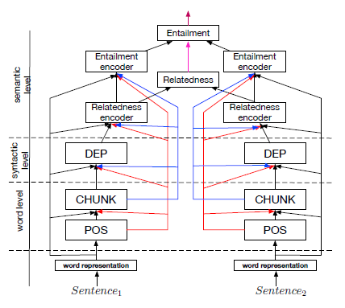
JOINT MANY-TASK MODEL

Slide 5
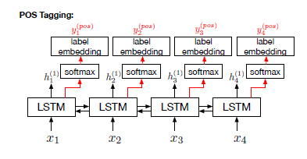
WORD-LEVEL TASK: POS TAGGING
Input-LSTM:
Input-softmax:
Output-softmax: The probability vector for each of the POS Tag.

Slide 6
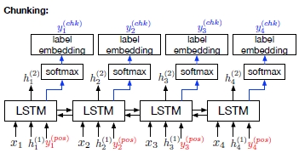
WORD-LEVEL TASK: CHUNKING
Input:
p is the probability value that the j-th POS tag is assigned to wt
is the corresponding label embedding

Slide 7
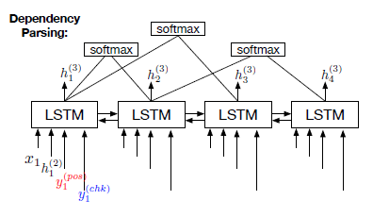
SYNTACTIC TASK: DEPENDENCY PARSING
Input:
match function:

Slide 8
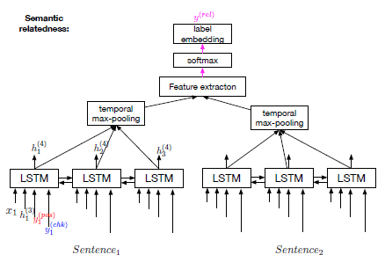
SEMANTIC TASK: SEMANTIC RELATEDNESS
max-pooling:
feature extraction:

Slide 9
SEMANTIC TASK: TEXTUAL ENTAILMENT
Use the max-pooling technique a in the semantic relatedness task.
Difference: do not use the absolute values of the element-wise subtraction, because need to identify which is the premise.

Slide 10
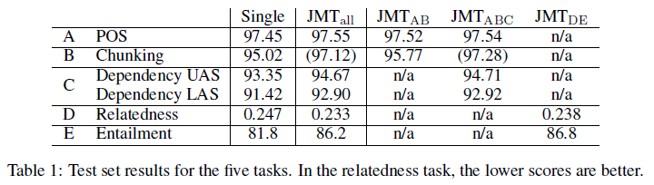
EXPERIMENTS

Slide 11
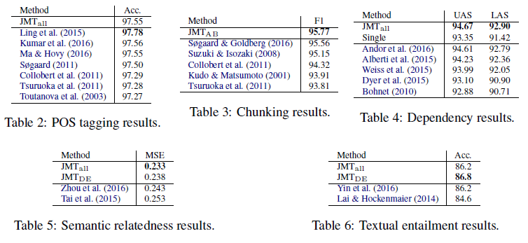
EXPERIMENTS

Slide 12
CONCLUSION
This paper presented a joint many-task model to handle a variety of NLP tasks with growing depth of layers in a single end-to-end deep model.

